Slide 1
SENTIMENTAL ANALYSIS ON SOCIAL MEDIA MARKETING
ABDUL RAYYAAN A R (192210532)
JAZIM. J (192210471)
GOPI S (192210522)

Slide 2
Table of contents
01
02
03
04
05
06
Introduction
Importance
Challenges faced
Code
Comparison of accuracies
Result

Slide 3

What is social media?
Overall, social media is a versatile tool that can enrich your life, facilitate connections, and offer a window into the broader world. It's a platform where you can learn, share, and engage in meaningful ways, enhancing both your online and offline experiences. Here you have some purposes of social media:
Personal connections: Connect with others, share moments, and express yourself
Information and entertainment: Stay informed, discover diverse content, and enjoy entertainment
Learning and social impact: Learn, contribute to causes, and engage in diverse communities

Slide 4
01
Introduction

Slide 5
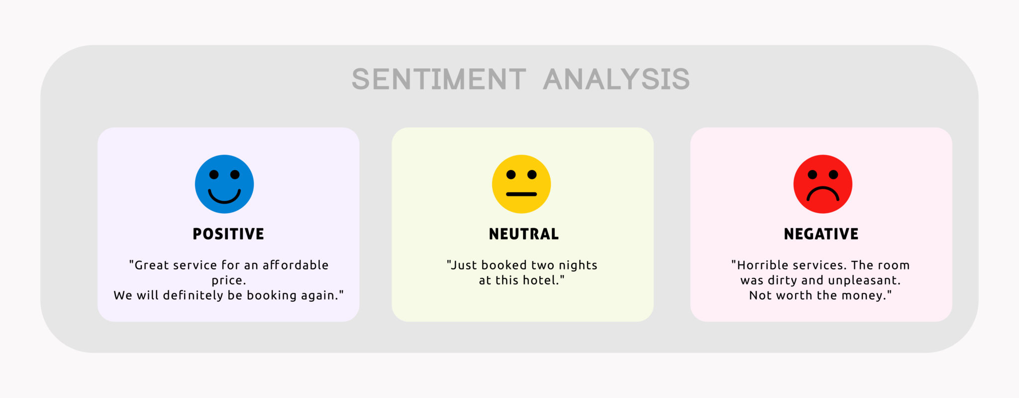
In today's digital age, Social media marketing has become a critical platform for brands to connect with their audience. This presentation explores a strategic approach for leveraging sentiments in social media marketing to drive brand success.
sentiment analysis enables marketers to track trends, identify influencers, and measure the impact of marketing initiatives in real-time.
Additionally, sentiment analysis empowers marketers to benchmark their brand sentiment against competitors, uncovering opportunities for differentiation and market positioning.

Slide 6
02
Importance

Slide 7
Importance
1
2
3
By deciphering the underlying emotions expressed within tweets, posts, reviews, and comments, marketers gain invaluable insights into the collective sentiment towards their brand.
This analytical prowess enables businesses to not only monitor their brand perception in real-time but also to decode customer feedback with precision.
sentiment analysis serves as a dynamic barometer for measuring campaign effectiveness, allowing brands to navigate the digital landscape with agility and purpose.

Slide 8
03
Challenges faced

Slide 9
Context Awareness
Multilingualism
Understanding the context in which text is written is crucial for accurate sentiment analysis. Without context, algorithms may misinterpret sentiments, leading to inaccuracies in analysis.
Sentiment analysis becomes more complex when dealing with multilingual text. Different languages have unique linguistic structures and cultural nuances that may require language-specific sentiment analysis models.
Imbalanced Data
Privacy Concerns
In real-world datasets, the distribution of sentiment labels may be imbalanced, with one sentiment class significantly outnumbering others. This imbalance can affect the performance of sentiment analysis models, leading to biased predictions.
Analyzing sentiment from user-generated content raises privacy concerns, particularly when dealing with personal or sensitive information. Ensuring compliance with privacy regulations and protecting user anonymity is essential in sentiment analysis applications.

Slide 10
04
Code

Slide 11
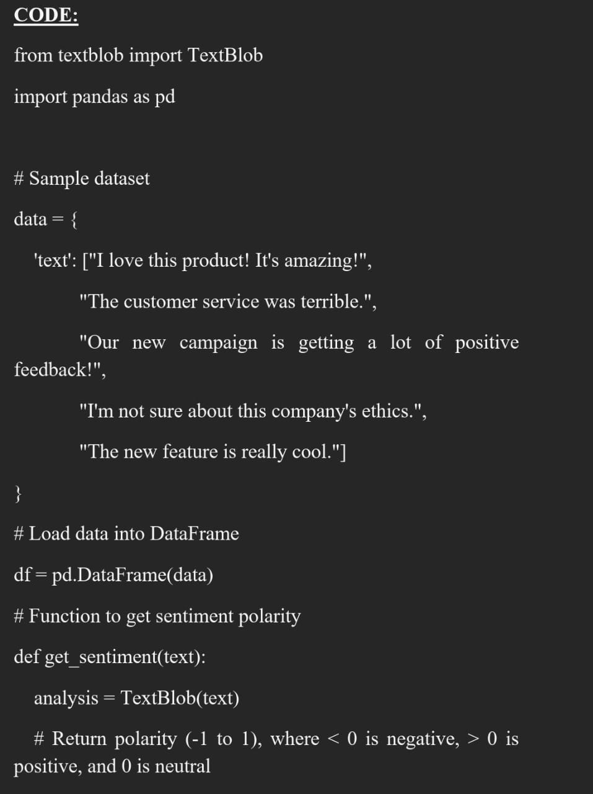
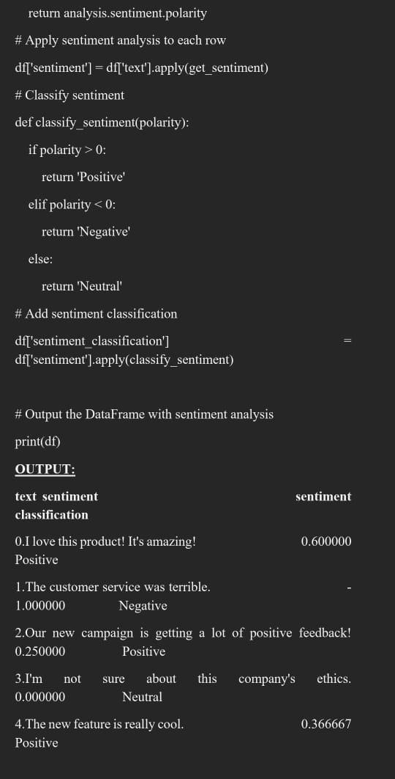

Slide 12
05
Comparison of accuracies

Slide 13
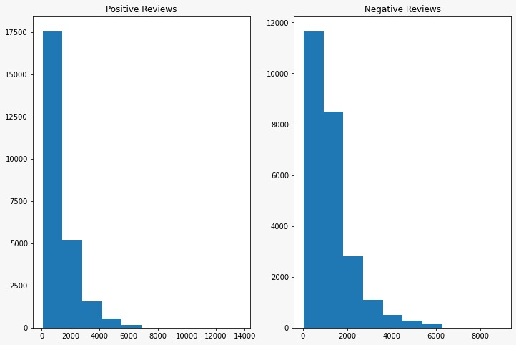
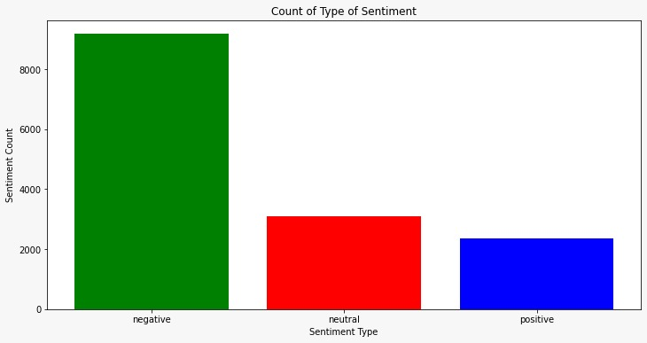
NAÏVE BAYES ALGORITHM
SUPPORT VECTOR MACHINE (SVM)

Slide 14
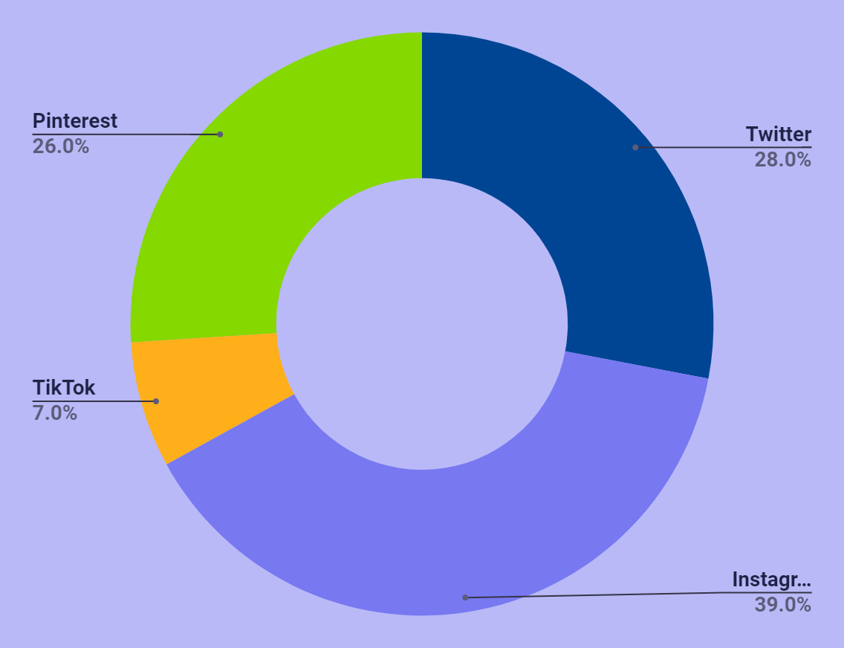
Engagement share
Twitter
Instagram
TikTok
Pinterest

Slide 15
06
RESULT

Slide 16
In summary, Naive Bayes emerged as the top-performing algorithm for sentiment analysis in social media marketing data, surpassing Support Vector Machines (SVM) in accuracy.
Its efficiency, simplicity, and interpretability make it a compelling choice for classifying sentiment in social media content.
However, ongoing validation and exploration of different algorithms are necessary to ensure robust and adaptable sentiment analysis strategies for diverse datasets and real-world applications.

Slide 17
THANKS!

